Slide 1
Software Engineering
Introduction
Version 2.0
© Maurizio Morisio, Luca Ardito 2024

Slide 2
Outline
Definitions and concepts
Process and product
Process and product properties
Laws
Principles

Slide 3
Motivation

Slide 4


Slide 5
Companies
Every successful company is becoming a software company
Amazon vs. Border’s
Netflix vs. Blockbuster
Apple, Google vs. Toyota, Volkswagen, GM, ..

Slide 6
People
Every citizen needs to become computer educated
Reading, writing, math, COMPUTING
Digital divide
Social and work exclusion of citizens who are computer illiterate

Slide 7
Software and Economy
The economies of ALL developed nations are dependent on software.
More and more systems are software controlled
Expenditure on software represents a significant fraction of GNP in all developed countries.

Slide 8
Definitions

Slide 9
Definition of Software Engineering
Multi person construction of multi version software
Multi person:
Issues in communication: misunderstandings, language gaps
Issues in coordination
Multi version:
Issue in maintenance over many years

Slide 10
Definition of Software
A collection of
Computer programs,
Procedures,
Rules,
Associated documentation
Data
Example:
Requirements document,
Project plan,
Test plan,
Test cases,
Build scripts,
Deployment scripts,
User manuals

Slide 11
Software Types
Embedded in non software product
Car, washing machine, ..
Production line (Industry 4.0)
Stand alone
Office suite, social network, ..
Embedded in enterprise
Information system

Slide 12
Software Criticality
Safety critical: harms people or environment
Self driving car
(usually embedded software)
Mission critical: harms business
Banking, finance, retail
(usually embedded in enterprise)
Other

Slide 13
Beware
Software is not free
Software changes (and it is not easy to change)
Software is not perfect
Software is complex

Slide 14
Process and Product

Slide 15
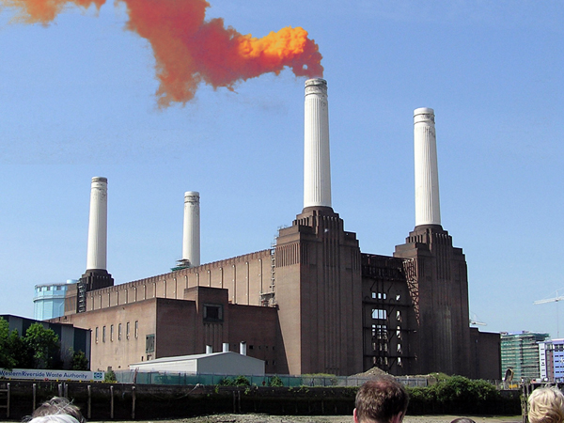
The Software “factory”

Slide 16
Classical Engineering
Design the product
Design the factory
Manufacture the product
Maintain the product

Slide 17
Classical Engineering
Software Engineering
Design the product
Design the factory
Manufacture the product
Maintain the product
Software product
Software Process
Deployment and Delivery
Evolution and Maintenance

Slide 18
Software Product
Functional properties
Do this…
Do that…
…
Use Cases

Slide 19
Software Product properties
Non functional properties
Usability
Effort needed to learn using the product (installation, day to day usage)
Satisfaction expressed by the user
Existence of functions needed by the user
Efficiency
For a given function in a given context: response time
For a given function / for a complete product:
Memory
CPU
Bandwidth
energy used

Slide 20
Software Product properties
Non functional properties
Reliability / availability
Defects visible by end user per time period / Probability of defect over a time period
Percentage of time the product is / is not available to end user
Maintainability
Effort (person hours) needed to add /modify / cancel a software function
Effort to fix a defect
Effort to deploy on a different platform (DB, OS, ..)

Slide 21
Software Product properties
Non functional properties
Security
Protection from malicious access
Access only to authorized users
Sharing of data
Safety
Absence of harm to persons
Absence of hazardous situations for persons
Dependability
Safety + security + reliability

Slide 22
Software Product properties
Non functional properties
Are difficult to engineer
Are often forgotten
Make the difference between competing products

Slide 23
Software process
Development
Operation
Maintenance

Slide 24
Software process – development phase
Requirements
Design
Coding
Testing

Slide 25

Classical Workbench
tools
process
workbench

Slide 26
Software Workbench
Git
Subversion
Polarion
Clearcase
Team Foundation Server

Slide 27
Software Tools
Requirements
Context diagram
Stakeholders
Stories / Personas
Use cases
Scenarios
Functional requirements
Non functional requirements
Glossary
....

Slide 28
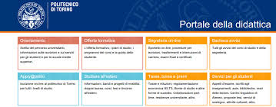





Software Tools in this course

Slide 29
Software Tools
Design
Component diagram
Package diagram
Class diagram
Interaction diagram
....

Slide 30
Software Tools
Development
Visual Studio Code
Intellij-Idea
Eclipse
Android Studio
Xcode
PyCharm
….

Slide 31
Software Tools
Test
Unit test, white box
Unit test, black box
....

Slide 32
Process Properties

Slide 33
Process Properties
Cost
Currency (€, $, …)
Effort
Person hours
Punctuality
Promised delivery date vs actual delivery date
Conformance (to standards, norms)

Slide 34
Laws

Slide 35
Software Engineering Laws
[Endres Rombach 2005]
Requirements deficiencies are the prime source of project failures
Requirements and design cause the majority of defects
Defects from requirements and design are the more expensive to fix

Slide 36
Software Engineering Laws
Modularity, hierarchical structures allow to manage complexity
Reuse guarantees higher quality and lower cost

Slide 37
Software engineering Laws
Good designs require deep application domain knowledge
© Michael Hilton,
Christian Kåstner

Slide 38
Software Engineering Laws
Testing can show the presence of defects, not their absence
A developer is unsuited to test his/her code

Slide 39
Software Engineering Laws
A system that is used will be changed
An evolving system will increase its complexity, unless work is done to reduce it
Architecture erosion
Requirements creep
Refactoring

Slide 40
Software Engineering Laws
Developer productivity varies considerably
Development effort is a (more than linear) function of size
Adding resources to a late project makes it later

Slide 41
Software Engineering Laws
The process should be adapted to the project

Slide 42
Information System laws
Conway’s law
Structure of a system produced by an organization mirrors the communication structure of the organization
Applied to organizational structure: the structure should mirror how members work together
Applied to information systems: IS parts will reflect the organizational structure
Applied to software projects: module interfaces will reflect the teams’ structure

Slide 43
Principles

Slide 44

KISS
Never add
accidental complexity to
essential complexity

Slide 45
Accidental complexity
Essential complexity
“Kindly extend your hand in my direction, bearing in mind the physical properties of the object commonly referred to as "salt," which is typically utilized as a seasoning agent to enhance the flavor profile of comestibles, and transmit it to my vicinity with a controlled force and trajectory so as to facilitate its transfer to my immediate possession, thus allowing for its incorporation into the culinary creation currently under consideration.”
Pass me the salt, please

Slide 46
“Complexity is your enemy. Any fool can make something complicated. It is hard to keep things simple.” [Richard Branson]

Slide 47
Separation of concerns
Given a large, difficult problem, try to split it in many (independent) parts, and consider a part at a time:
In war: divide and conquer
In SE: software process, concentrate on what the system should do, then on how, then do it
In SE: programming languages, separate error handling and error generation
In SE: divide complex system in (independent) components (modules)

Slide 48
Separation of concerns
Divide a complex system in modules, with high cohesion and low coupling
high coupling
low coupling

Slide 49
Separation of concerns
Examples
ISO OSI communication stack, 7 layers
3 layers architecture (data base, application logic, presentation)
Model View Controller

Slide 50
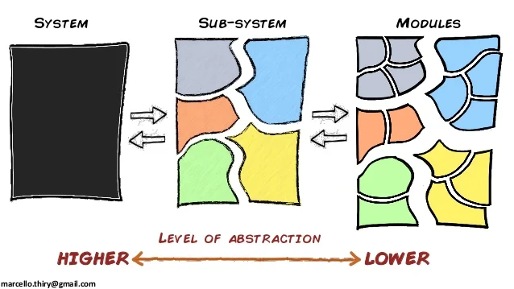
Abstraction
Given a difficult problem or system, extract a simpler view of it, avoiding unneeded details, then reason on the abstract view (model)

Slide 51


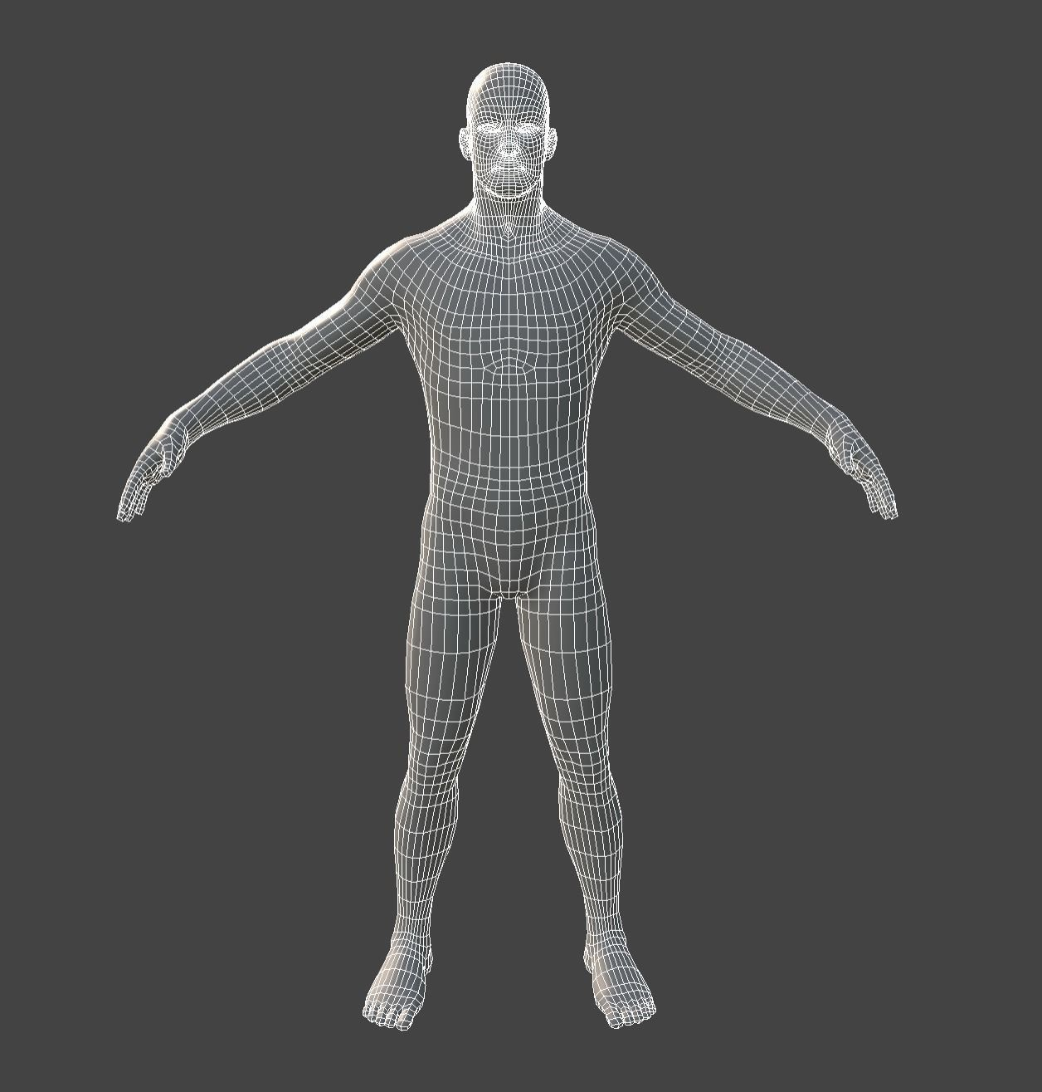
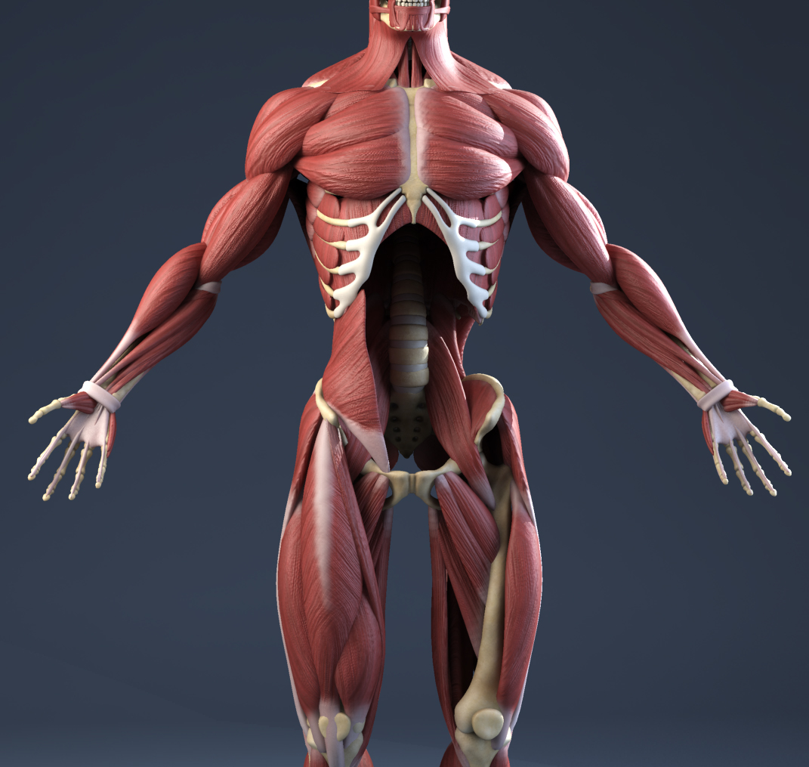

Slide 52
Recap
Software is not only code
Software process, software products
Properties
Laws of Software Engineering and Information Systems
Principles to be followed

